Slide 1
Angular 7 - Tutorial
1.Introduction

Slide 2
Prerequisite
HTML
CSS
Javascript
Basics of Typescript
Programming concepts (Variables, arrays, conditions. Loops, functions etc)

Slide 3
Introduction
Javascript Framework
Created and Maintained by Google
Front end application / Front end part of a full stack application
Written in Typescript
Angularjs(Not recommended) → Angular2 currently called as Angular.
Current version is Angular7 is having same framework with small changes

Slide 4
Why angular
Organized front end structure(Components, modules & Services)
Single Page application
A part of MEAN stack
Modular Approach
Re-Usable code
Unit testable
Develop across all platforms (Desktop, mobile, web)
Speed and Performance
Loved by millions

Slide 5
Angular History
2010 – Angular JS
2016 – Angular 2 (Currently called as Angular)
2016 Dec – Angular 4 (Angular 3 was skipped to avoid confusion due to misalignment of the router package)
2017 Nov – Angular 5
2018 Apr - Angular 6
2018 Oct – Angular 7

Slide 6
Next Video….
2. Angular Installation & Hello World

Slide 7
Development Environment
Node
Npm
Angular CLI
Text Editor – Visual Studio Code

Slide 8

Installation – Node, NPM, VSC
Install Node & NPM
https://nodejs.org/en/download/
Download and install based on your OS
Along with node js, npm(node package manager will also get install
Install Visual Studio Code Editor
https://code.visualstudio.com/download

Slide 9
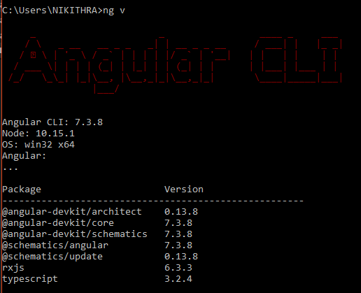
Installation – Angular CLI
Install Angular CLI
Angular CLI is the command line interface of Angular allows to generate building block of application by typing the commands
Helps development Quicker and easier all these with following best practices
Installation Cmd:
npm install –g @angular/cli

Slide 10
Chapter 1 : hello world
Your first typescript application

Slide 11
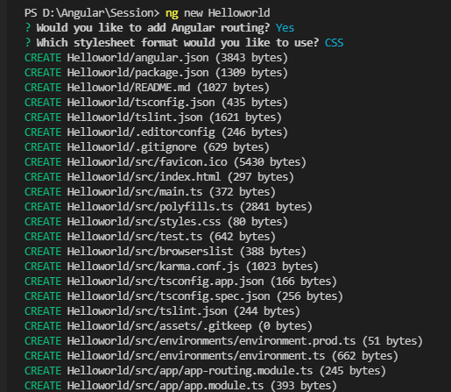
1.1 Hello world - Creation
Create Application
Terminal Output
Open Visual Studio Code and it has internal terminal to execute commands
Go to Terminal → Internal Terminal
In the terminal Enter the following command to create new Angular Project
ng new HelloWorld

Slide 12
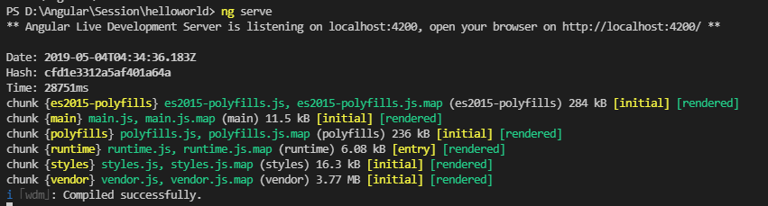
1.2 Hello world – Run and Terminal Output
Run Application
In Terminal navigate into application folder using cd cmd: cd HelloWorld
Now run the application using the cmd: ng serve
Terminal Output

Slide 13
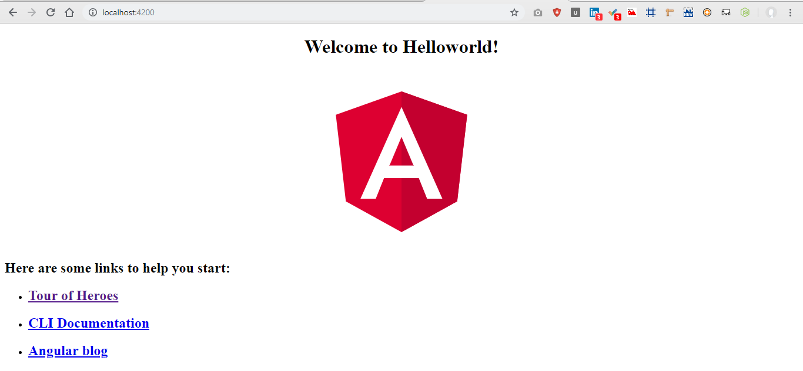
1.2 Hello world – Browser Output
Open Browser and type http://localhost:4200 which we get from terminal

Slide 14
Chapter 2 : basic types
Boolean : True/false
Number: 1,2,3,4,5
String: “anything”
Array: [1,2,3,4,5]
Union: Multiple datatype
Tuple: {“1”:”hai”}
Enum: Object
Any: No datatype
Void: no return type
Type assertion: Convert one datatype into another

Slide 15
Variable declaration
1. Declare a variable with type & data
Var [Identifier] : [type] = [value];
var studentName: string = “Madhavan”;
2. Declare a variable with type & without data
Var [Identifier] : [type];
Var studentName: string;
3. Declare a variable without type & with data
Var [Identifier] = [value]
Var studentName = 1;
4. Declare a variable
Var [Identifier] ;
Var studentName ;

Slide 16
2.1 Boolean & NUmber
// boolean
var isHuman:boolean = true;
console.log(isHuman)
PS D:\Angular\Typescript\TS_WK> tsc basictypes.ts
PS D:\Angular\Typescript\TS_WK> node basictypes.js
true
//number
var myNumber:number=22;
console.log(myNumber)
PS D:\Angular\Typescript\TS_WK> tsc basictypes.ts
PS D:\Angular\Typescript\TS_WK> node basictypes.js
22

Slide 17
2.2 String, aRRAY, Union
//string
var myString:string="Welcome";
console.log(myString)
//union
let val:string|number
val = 12
console.log("numeric value of val "+val)
val = "This is a string"
console.log("string value of val "+val)
PS D:\Angular\Typescript\TS_WK> tsc basictypes.ts
PS D:\Angular\Typescript\TS_WK> node basictypes.js
Welcome
PS D:\Angular\Typescript\TS_WK> tsc basictypes.ts
PS D:\Angular\Typescript\TS_WK> node basictypes.js
two
numeric value of val 12
string value of val This is a string
//array
var myArray:string[]=["hai", "welcome", "Thanks"];
console.log(myArray)
PS D:\Angular\Typescript\TS_WK> tsc basictypes.ts
PS D:\Angular\Typescript\TS_WK> node basictypes.js
[ 'hai', 'welcome', 'Thanks' ]

Slide 18
2.3 tUPLE & Enum
//tuple
let myTuple:[string,number] = ["one",1];
console.log(myTuple)
PS D:\Angular\Typescript\TS_WK> tsc basictypes.ts
PS D:\Angular\Typescript\TS_WK> node basictypes.js
[ 'one', 1 ]
//enum
enum players {
virat = 12,
sachin = 10,
Dhoni = 7
}
let viratJersy = players.virat;
console.log('virat jersy no: '+ viratJersy);
PS D:\Angular\Typescript\TS_WK> tsc basictypes.ts
PS D:\Angular\Typescript\TS_WK> node basictypes.js
virat jersy no: 12

Slide 19
2.4 Any, void & type assertion
//any
let myNum:any = "two";
console.log(myNum);
PS D:\Angular\Typescript\TS_WK> tsc basictypes.ts
PS D:\Angular\Typescript\TS_WK> node basictypes.js
two
//void
let myUndefinedVar: void = undefined;
console.log('myUndefinedVar '+ myUndefinedVar);
PS D:\Angular\Typescript\TS_WK> tsc basictypes.ts
PS D:\Angular\Typescript\TS_WK> node basictypes.js
myUndefinedVar undefined
//type assertion
let code: any = 123;
let employeeCode = <number> code;
console.log(typeof(employeeCode));
PS D:\Angular\Typescript\TS_WK> tsc basictypes.ts
PS D:\Angular\Typescript\TS_WK> node basictypes.js
number

Slide 20
Chapter 3 : interfaces
An interface is a syntactical contract that an entity should conform to
Interfaces define properties, methods, and events, which are the members of the interface.
Interfaces contain only the declaration of the members.
It is the responsibility of the deriving class to define the members.
It often helps in providing a standard structure that the deriving classes would follow.
3.1 : Interface
3.2 : Optional in interface
3.3 : Interface implementation
3.4 : Multiple Interfaces

Slide 21
3.1 interface
interface iCricInfo{
name : string;
jersyNo : number;
}
function giveDetails (info:iCricInfo) {
return "The cricket player name is " +info.name+ " and his jersy no is "+info.jersyNo
}
giveDetails ({name: "Virat", jersyNo:12});
PS D:\Angular\Typescript\TS_WK> tsc interface.ts
PS D:\Angular\Typescript\TS_WK> node interface.js
Details of Virat :The cricket player name is Virat and his jersy no is 12

Slide 22
3.2 optional in interface
interface iCricInfo{
name : string;
jersyNo? : number;
}
function player (info:iCricInfo) {
if(info.jersyNo) {
return "The cricket player name is " +info.name+ " and his jersy no is "+info.jersyNo
} else {
return "The cricket player name is " +info.name
}
}
let viratDetails = player ({name: "Virat"});
console.log("Details of Virat :"+ viratDetails);
PS D:\Angular\Typescript\TS_WK> tsc interface.ts
PS D:\Angular\Typescript\TS_WK> node interface.js
Details of Virat :The cricket player name is Virat

Slide 23
3.2 interface implementation
interface iCricInfo{
name : string;
jersyNo? : number;
getInfo(): string;
}
class cricketer implements iCricInfo {
constructor (public name:string, public jersyNo:number) {}
getInfo(){
return "The cricket player name is "+this.name+" and his jersy no is " +this.jersyNo;
}
}
let virat = new cricketer("Virat", 12);
console.log("Virat Details :"+ virat.getInfo());
PS D:\Angular\Typescript\TS_WK> tsc interfaceImpl.ts
PS D:\Angular\Typescript\TS_WK> node interfaceImpl.js
Virat Details :The cricket player name is Virat and his jersy no is 12

Slide 24
3.2 multiple interfaces
interface iPlayerDetails{
name : string;
jersyNo? : number;
}
interface iBatsman extends iPlayerDetails{
battingStyle : string;
}
interface iBowler extends iPlayerDetails{
bowlingStyle : string;
}
interface iAllrounder extends iBatsman, iBowler{
}
//will cont…
let allRounder1 = <iAllrounder>{};
allRounder1.name = "Hardhik Pandya";
allRounder1.jersyNo = 33;
allRounder1.battingStyle = "Right hand";
allRounder1.bowlingStyle = "Speed";
console.log (allRounder1);
PS D:\Angular\Typescript\TS_WK> tsc multipleInterfaces.ts
PS D:\Angular\Typescript\TS_WK> node multipleInterfaces.js
{ name: 'Hardhik Pandya',
jersyNo: 33,
battingStyle: 'Right hand',
bowlingStyle: 'Speed' }

Slide 25
Chapter 4 : classes
A class in terms of OOP is a blueprint for creating objects.
A class encapsulates data for the object.
Typescript gives built in support for this concept called class.
JavaScript ES5 or earlier didn’t support classes.
Typescript gets this feature from ES6.

Slide 26
4.1 classes
class Score {
constructor(public runs:number, public balls:number) {}
addRuns(newScore: Score) {
return new Score (this.runs + newScore.runs, this.balls + newScore.balls);
}
totalScore (){
return "Overall score of the match is " +this.runs + " runs in "+this.balls + " balls";
}
}
let initialScore = new Score (150,150);
let newScore = new Score(200, 150);
let finalScore = initialScore.addRuns(newScore);
console.log (finalScore.totalScore());
PS D:\Angular\Typescript\TS_WK> tsc classes.ts
PS D:\Angular\Typescript\TS_WK> node classes.js
Overall score of the match is 350 runs in 300 balls

Slide 27
4.2 multiple classes(1)
class ScoreBoard {
constructor(public runs:number, public balls:number) {}
addRuns(newScore: ScoreBoard) {
return new ScoreBoard (this.runs + newScore.runs, this.balls + newScore.balls);
}
totalScore (){
return "Overall score of the match is " +this.runs + " runs in "+this.balls + " balls";
}
}

Slide 28
4.2 multiple classes(2)
class FullScoreBoard extends ScoreBoard {
constructor(public runs:number, public balls:number, public fours:number, public sixes:number) {
super(runs,balls);
}
addRuns(newScore: FullScoreBoard) {
var prevScore = super.addRuns(newScore);
return new FullScoreBoard (prevScore.runs, prevScore.balls, this.fours + newScore.fours, this.sixes + newScore.sixes);
}
totalScore (){
return "Overall score of the match is " +this.runs + " runs in "+this.balls + " balls having " +this.fours + " fours and " +this.sixes+ " sixes";
}
}
PS D:\Angular\Typescript\TS_WK> tsc MultipleClasses.ts
PS D:\Angular\Typescript\TS_WK> node MultipleClasses.js
Overall score of the match is 570 runs in 600 balls having 14 fours and 5 sixes
let match1 = new FullScoreBoard(320, 300, 9, 3);
let match2 = new FullScoreBoard(250, 300, 5, 2);
let totalScore = match1.addRuns(match2);
console.log(totalScore.totalScore());

Slide 29
Chapter 5 : object
An object is an instance which contains set of key value pairs.
The values can be scalar values or functions or even array of other objects.
5.1 : Object Notation
5.2 : Object as function parameter
5.3 : Anonymous Object

Slide 30
5.1 object Notation
//object contains property
var person = {
firstName : "Monicka",
lastName: "Akilan"
}
console.log(person.firstName);
console.log(person.lastName);
PS D:\Angular\Typescript\TS_WK> tsc object.ts
PS D:\Angular\Typescript\TS_WK> node object.js
Monicka
Akilan
//object contains property and function
var person = {
firstName : "Monicka",
lastName: "Akilan",
sayHello: function() {}
}
person.sayHello = function(){
console.log("function says: "+ person.firstName);
} person.sayHello();
PS D:\Angular\Typescript\TS_WK> tsc object.ts
PS D:\Angular\Typescript\TS_WK> node object.js
function says: Monicka

Slide 31
5.2 Objects as function parameters
//object as function parameters
var person2 = {
firstName : "Monicka",
lastName: "Akilan",
}
var callPerson = function(obj:{firstName:string, lastName:string}) {
console.log("callPerson firstName: "+ obj.firstName);
console.log("callPerson lastName: "+ obj.lastName);
}
var callPerson2 = function(obj) {
console.log("callPerson2 firstName: "+ obj.firstName);
console.log("callPerson2 lastName: "+ obj.lastName);
}
callPerson(person2);
callPerson2(person2);
PS D:\Angular\Typescript\TS_WK> tsc object.ts
PS D:\Angular\Typescript\TS_WK> node object.js
callPerson firstName: Monicka
callPerson lastName: Akilan
callPerson2 firstName: Monicka
callPerson2 lastName: Akilan

Slide 32
5.3 Anonymous object
//Anonymous Objects
var callPerson3 = function(obj:{firstName:string, lastName:string}) {
console.log("callPerson3 firstName: "+ obj.firstName);
console.log("callPerson3 lastName: "+ obj.lastName);
}
callPerson3({firstName:"Monicka", lastName:"Akilan"});
PS D:\Angular\Typescript\TS_WK> tsc object.ts
PS D:\Angular\Typescript\TS_WK> node object.js
callPerson3 firstName: Monicka
callPerson3 lastName: Akilan

Slide 33
Chapter 6 : Namespace
A namespace is a way to logically group related code.
This is inbuilt into TypeScript unlike in JavaScript where variables declarations go into a global scope and if multiple JavaScript files are used within same project there will be possibility of overwriting or misconstruing the same variables, which will lead to the “global namespace pollution problem” in JavaScript.
5.1 : Object Notation
5.2 : Object as function parameter
5.3 : Anonymous Object

Slide 34
6.1 Defining a Namespace
A namespace definition begins with the keyword namespace followed by the namespace name as follows −
namespace SomeNameSpaceName {
export interface ISomeInterfaceName { }
export class SomeClassName { }
}
The classes or interfaces which should be accessed outside the namespace should be marked with keyword export.
To access the class or interface in another namespace, the syntax will be namespaceName.className
SomeNameSpaceName.SomeClassName;
If the first namespace is in separate TypeScript file, then it should be referenced using triple slash reference syntax.
/// <reference path = "SomeFileName.ts" />

Slide 35
Chapter 7 : modules
A module is designed with the idea to organize code written in TypeScript. Modules are broadly divided into −
Internal Modules
External Modules
Internal modules came in earlier version of Typescript.
This was used to logically group classes, interfaces, functions into one unit and can be exported in another module.
This logical grouping is named namespace in latest version of TypeScript.
So internal modules are obsolete instead we can use namespace.
Internal modules are still supported, but its recommended to use namespace over internal modules.

Slide 36
7.1 External module
External modules in TypeScript exists to specify and load dependencies between multiple external js files.
If there is only one js file used, then external modules are not relevant. Traditionally dependency management between JavaScript files was done using browser script tags (<script></script>). But that’s not extendable, as its very linear while loading modules.
That means instead of loading files one after other there is no asynchronous option to load modules.
When you are programming js for the server for example NodeJs you don’t even have script tags.
There are two scenarios for loading dependents js files from a single main JavaScript file.
Client Side - RequireJs
Server Side - NodeJs

